Slide 1
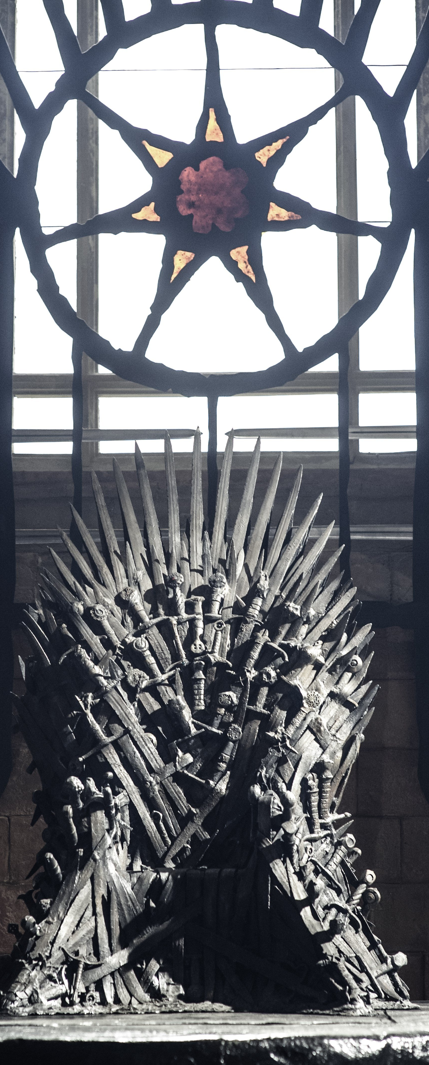
Game of thrones nlp
Kevin Dolan
TEDS
March 2021

Slide 2
Agenda
Problem statement
Data summary
model
Similarity scores
Logistic regression
Impact/next steps

Slide 3
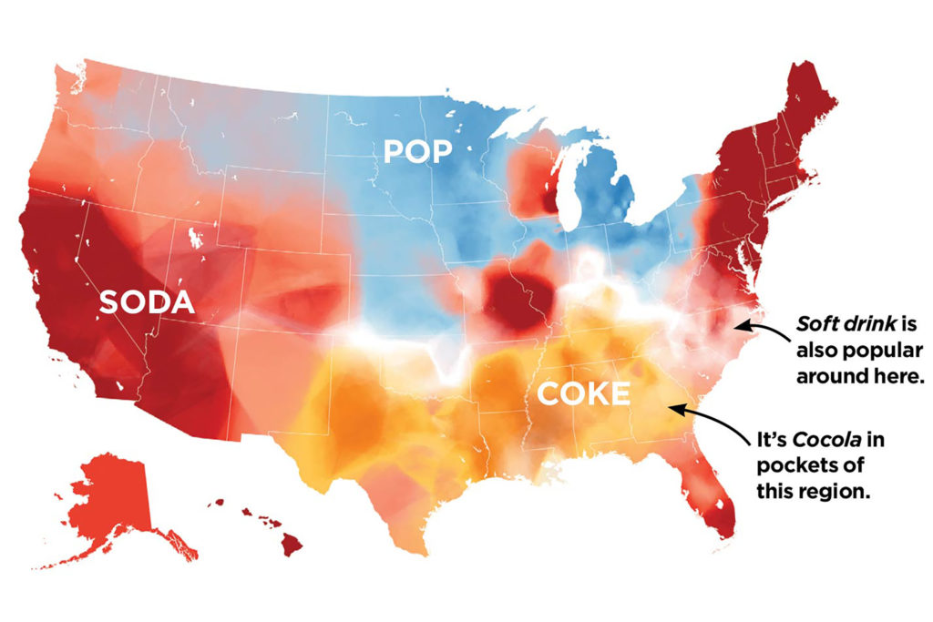
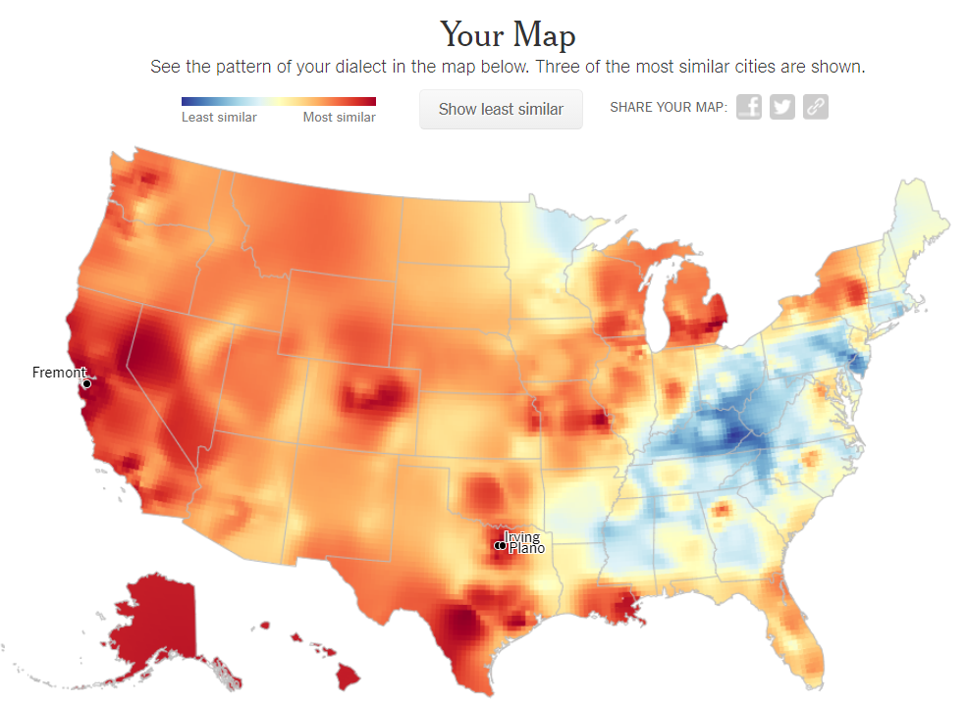
Problem statement
Can class and relationships be identified by speech patterns?
In the Game of Thrones universe, each character’s prospects are largely fixed at birth by their social class and relationships. In several cases, character identities are revealed to others by the way they speak. We investigated whether these factors could be detected using Natural Language Processing (NLP).
Practical application
While real-world class lines are less rigid than in Game of Thrones, grammatical structures and choice of words can be highly revealing of socioeconomic status and background. Similar frameworks could be applied to interviewing, admissions applications, geospatial data, etc.

Slide 4
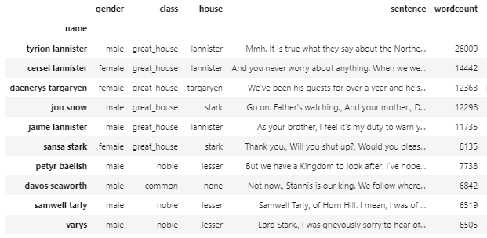
Data summary
Source Data
The full script of the series run of Game of Thrones, scraped from Genius¹
Demographic data (sex, class, house) from a large Game of Thrones fan analysis on Github²
https://www.kaggle.com/albenft/game-of-thrones-script-all-seasons?select=Game_of_Thrones_Script.csv
https://github.com/jeffreylancaster/game-of-thrones/tree/master/data
430 characters
24,000 lines
288,000 words

Slide 5
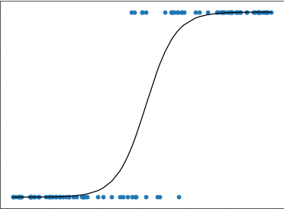
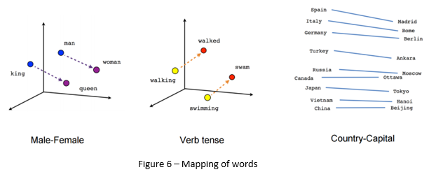
Modeling
Logistic regression
This model is appropriate for binary predictions. We used it to predict whether a given character is “noble” or “common” based on their dialogue throughout the series.
Logistic Regression
Natural language Processing
We used the Spacy NLP library to encode each character’s dialogue into a “vector”, assigning each word a machine-readable numerical position that we could add to our regression model.
NLP Vectors

Slide 6
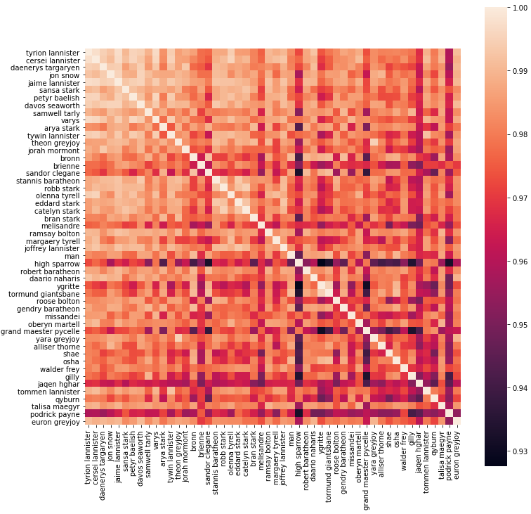
Results: similarity analysis
Similarity scores
We built a matrix comparing each of the top 50 characters by wordcount, to see who was most alike. Then, we identified which character was the best and worst match for each other character.
We identified several clusters of high similarity:
“Common” characters (Tormund, Gilly, Gendry)
Scheming, snarky characters (Petyr Baelish, Varys, Olenna Tyrell)
Gruff, profane characters (Bronn, the Hound, Alliser Thorne)
Earnest “good-guy” characters (Jon Snow, Davos Seaworth, and Samwell Tarly)
Characters’ speech patterns clearly reflect their relationships, class, & temperament
Notes:
Note: King Joffrey and Jon Snow are much more like their actual families

Slide 7
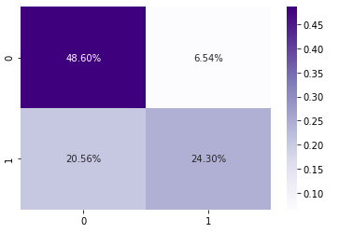
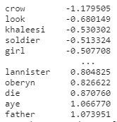
Results: logistic regression
Model accuracy: 73%
Our model matches the correct class to the character 73% of the time.
baseline: 55%
45% of characters in the dataset are noble, so if we just assumed everyone in the dataset was a commoner, we’d be right 55% of the time.
The model is very good at identifying commoners, but tends to mistakenly identify some noble characters as common.
Cross-Validation Scores
These are the words most strongly associated with “commonness” and nobility, respectively
Cross-validation shows that our initial accuracy score is indicative of how the model would perform on unseen data.

Slide 8
Impact and next steps
Model applications
This model was easy to train on class because class in Game of Thrones is unambiguous – replicating this model with real-world socioeconomic indicators would be more challenging.
However, the same methods could be used to identify other indicators, such as:
Levels of education
Birthplace
Cultural or ideological affinities
Influence networks
Such information could be used to guide investigation or corroborate other identifying data in counter-terrorism or law enforcement contexts.
Next steps
Given more time, I would like to refine my analysis of the text to include the following features:
N-gram and part-of-speech analyses, to look for grammatical structures that predict class
Profanity identification, to determine if there are class-rooted differences in the ways the characters use profanity
Sentiment analysis, to see if certain people have a persistent and detectable overall affect.
Class scores for each character, to identify characters whose speech patterns are most emblematic of their class.

Slide 9
Questions?

Slide 10
Impact and next steps

